Slide 1
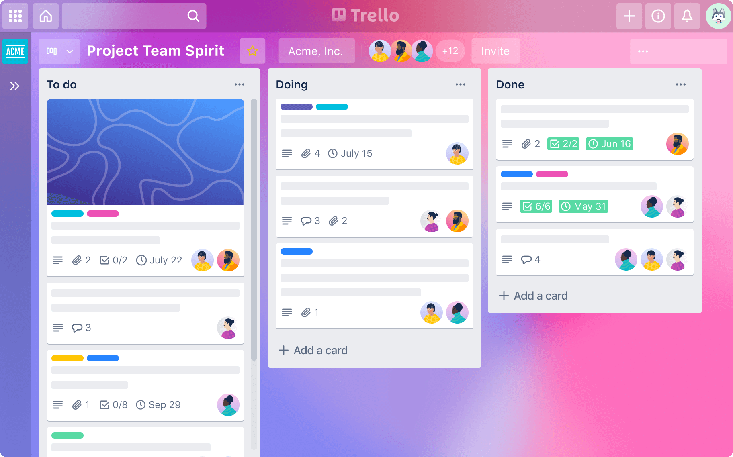


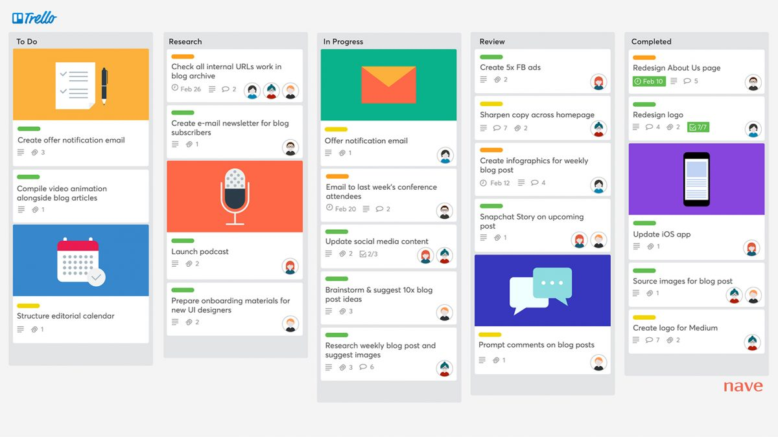

API Testing
Presented By : Nebyat Bekele
Department of Software Engineering | 2024

Slide 2
OVERVIEW
Introduction
Requirement
Planning
Testcase
Tractability Matrix
Environment setup
Execution
Report
AASTU| 2024

Slide 3

1
INTRODUCTION
Trello is a visual project management application based on the Kanban methodology, offering a structured approach to organizing tasks and projects.
It operates through the use of boards
Tasks are represented as cards within lists
Cards can be customized with detailed metadata
AASTU| 2024

Slide 4
2
REQUIREMENT
FUNCTIONAL REQUIREMENT
FR1: The system shall allow users to create boards to organize projects.
FR2: The system shall support adding lists to boards.
FR3: The system shall enable users to create cards within lists.
FR4: The system shall allow users to see announcements and notifications.
FR5: The system shall enable user to add comments
FR5: The system could provide a search option
AASTU| 2024

Slide 5
3
CONT...
NON-FUNCTIONAL REQUIREMENT
NFR-PERF-001: The system shall respond to user actions within 2 seconds.
NFR-RELI-001: The system shall be available 99.9% of the time during business hours.
NFR-USE-001: The user interface should be intuitive and accessible, following WCAG guidelines for web accessibility.
AASTU| 2024

Slide 6
4
PLANNING
OBJECTIVE
Verify the functionality of Trello
Assess the performance of Trello,
AASTU| 2024
SCOPE
The testing will focus on the core features and functionalities of Trello, including task creation, assignment, announcements, notifications, and reporting.

Slide 7
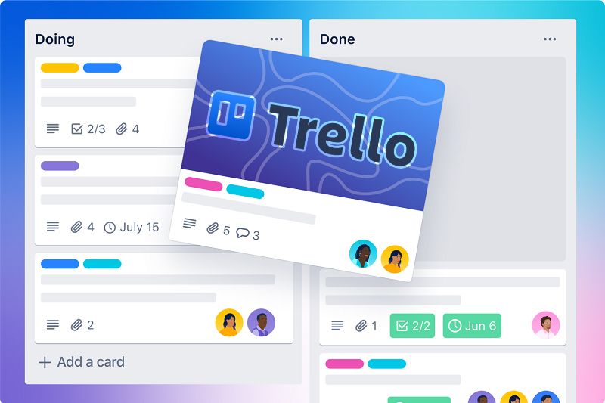
5
CONT..
TEST TYPE
TESTING TECHNIQUES
API Testing
Compatibility Testing
Equivalence Partitioning
Boundary Value Analysis
AASTU| 2024

Slide 8
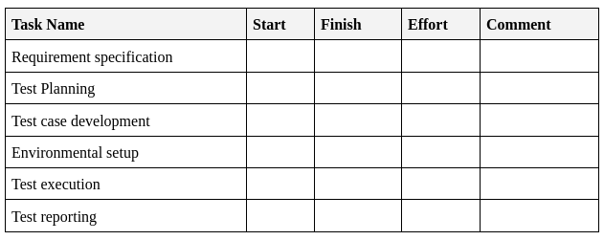
6
CONT..
SCHEDULE
AASTU| 2024

Slide 9
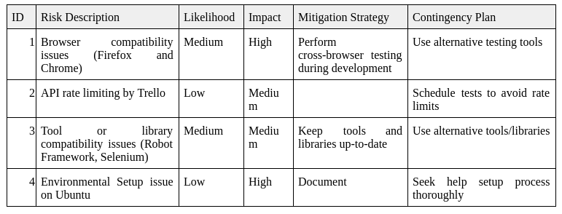
7
CONT..
RISK MATRIX
AASTU| 2024

Slide 10
1
TEST SUITE
Board Management
Add with valid fields
Add with empty name
List boards
List Management
Add List with exciting Bard
Add list with deleted board
Add list with out name
Card Management
Same with above
Commenting
add valid comment
add empty comment
Notifications and Announcement
get All notifications
Searching and Indexing
AASTU| 2024

Slide 11
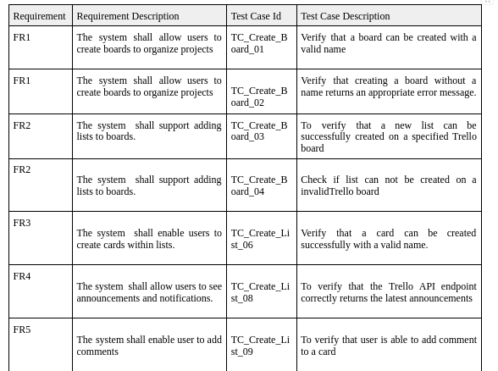
9
TRACTABILITY MATRIX
AASTU| 2024

Slide 12

10
ENVIRONMENT SETUP
Folder Structuring
library
resources
results
tests
Tools Selection
Robot Framework
Vscode
Chrome devtools
installation and
configuration
AASTU| 2024
Execution and Reporting
Test Script Writing

Slide 13
11
CONT..
# library/CustomKeywords.py
import requests
import ast
class CustomKeywords:
def make_request(self, method, url, headers, payload=None):
if isinstance(headers, str):
headers = ast.literal_eval(headers)
response = requests.request(method, url, headers=headers, json=payload)
response.raise_for_status()
return {
"status_code": response.status_code,
"json": response.json()
}
# resources/CommonKeywords.robot
*** Settings ***
Library ../library/CustomKeywords.py
*** Keywords ***
Make API Request
[Arguments] ${method} ${url} ${headers} ${payload}=None
${response}= Make Request ${method} ${url} ${headers} ${payload}
[Return] ${response}
AASTU| 2024
Test Script Writing

Slide 14
11
# tests/TestSuite.robot
*** Settings ***
Resource ../resources/CommonKeywords.robot
Variables ../resources/CommonVariables.py
Library Collections
Library JSONLibrary
Variables VariableFile.py
*** Test Cases ***
TC_AddComment_09
[Documentation] To verify that user is able to add comment to a card
${url}= Set Variable https://trello.com/1/cards/667b0d6545c914f2ec9c8eca/actions/comments
${response}= Make API Request POST ${url} ${HEADERS} ${NEW_COMMENT}
Log ${response}
Should Be True ${response} != {}
CONT..
AASTU| 2024
Test Script Writing

Slide 15
12
EXECUTION
EXECUTION SCRIPT
#!/bin/bash
test_suites=("TestSuite_Search.robot" "TestSuite_AddComment.robot" "TestSuite_GetAnnouncement.robot" "TestSuite_CreateBoard.robot" "TestSuite_CreateList.robot" "TestSuite_CreateCard.robot")
for suite in "${test_suites[@]}"; do
base_name=$(basename "$suite" .robot)
robot -d results -o "${base_name}_output.xml" -l "${base_name}_log.html" -r "${base_name}_report.html" "tests/$suite"
done
AASTU| 2024
Execution Output files
_output.xml
_log.html
_report.html

Slide 16
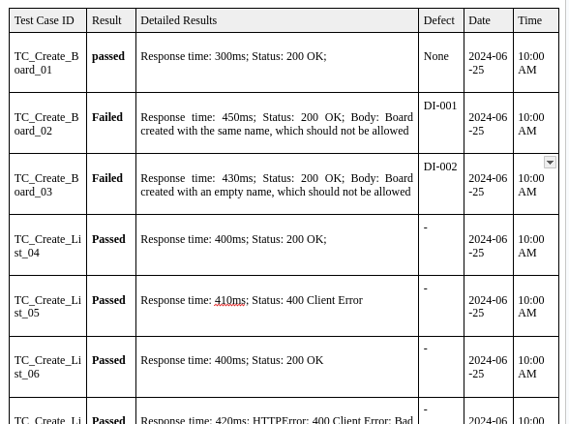
1
REPORT
TEST RESULT
AASTU| 2024

Slide 17
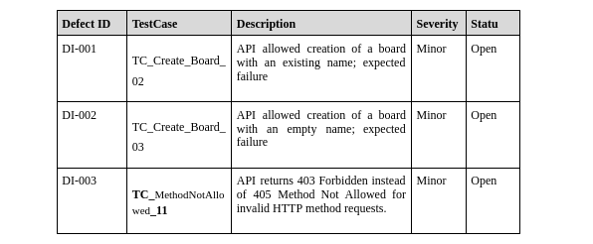
1
REPORT
DEFECTS
AASTU| 2024

Slide 18
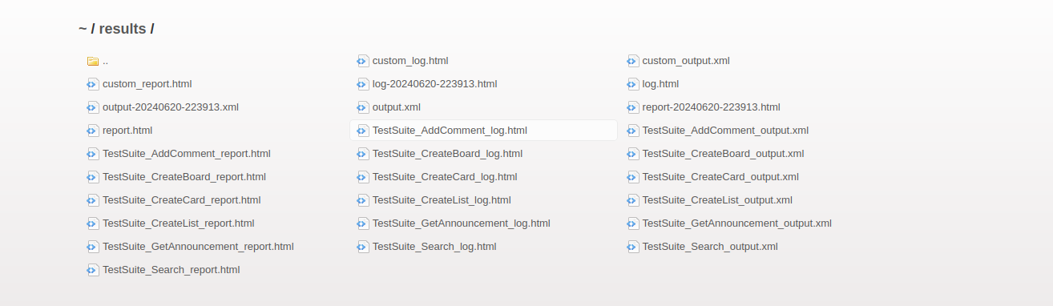
1
REPORT
SCREENSHOTS
AASTU| 2024

Slide 19
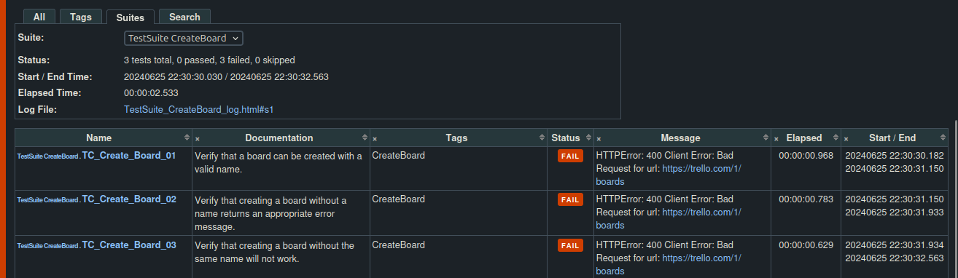
1
CONT..
SCREENSHOTS
AASTU| 2024

Slide 20
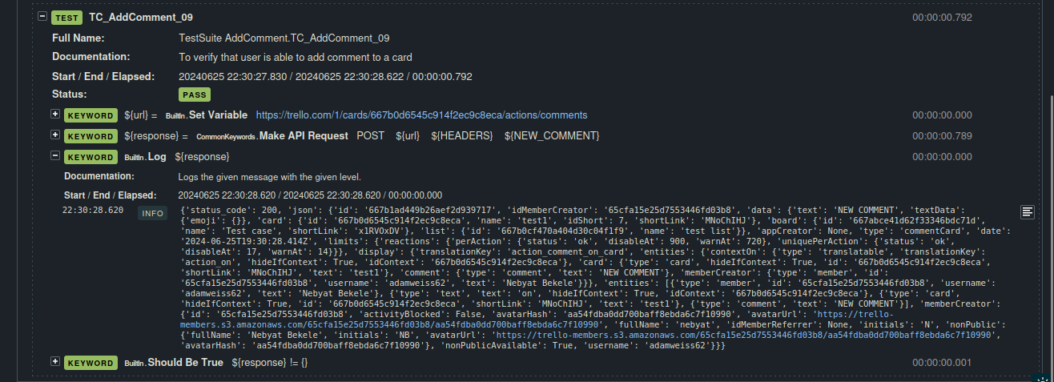
1
CONT..
SCREENSHOTS
AASTU| 2024

Slide 21
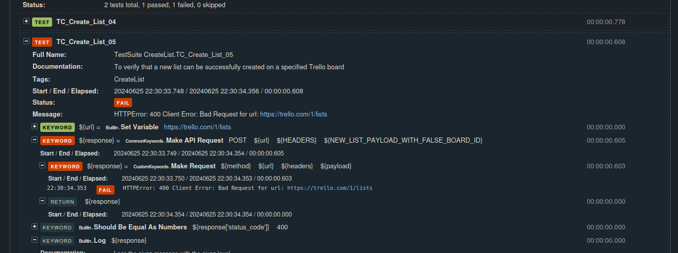
1
CONT..
SCREENSHOTS
AASTU| 2024

Slide 22
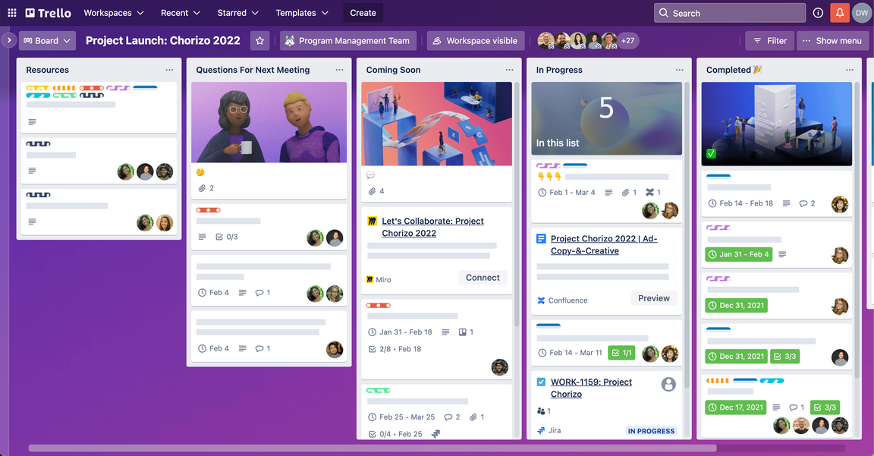
1
CONCLUSION
Overall, the test execution process yielded positive results, with the majority of test cases passing successfully.
AASTU| 2024

Slide 23
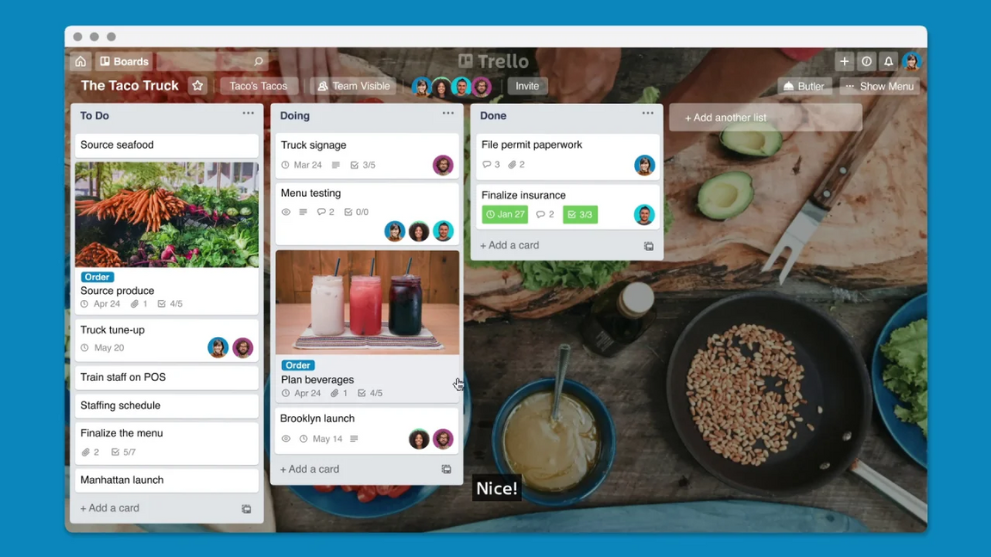
THANK YOU
Presented By :Nebyat Bekele

